Slide 1
Disparities and Program Participation
Disability Statistics and Measuring Disparities

Slide 2
Agenda
Introducing the Compendium and the Annual Report
Comparing social and economic indicators for people with and without disabilities
Conclusion

Slide 3
Available Products
https://disabilitycompendium.org/

Slide 4

ACS: Population Statistics

Slide 5
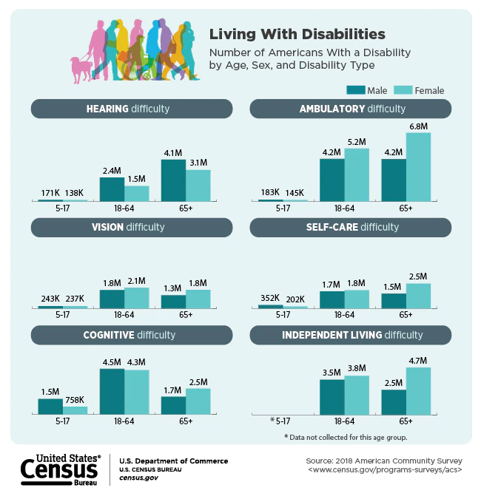
Infographic

Slide 6
Prevalence of Disability by Type in the US
Source: American Community Survey (2018)

Slide 7
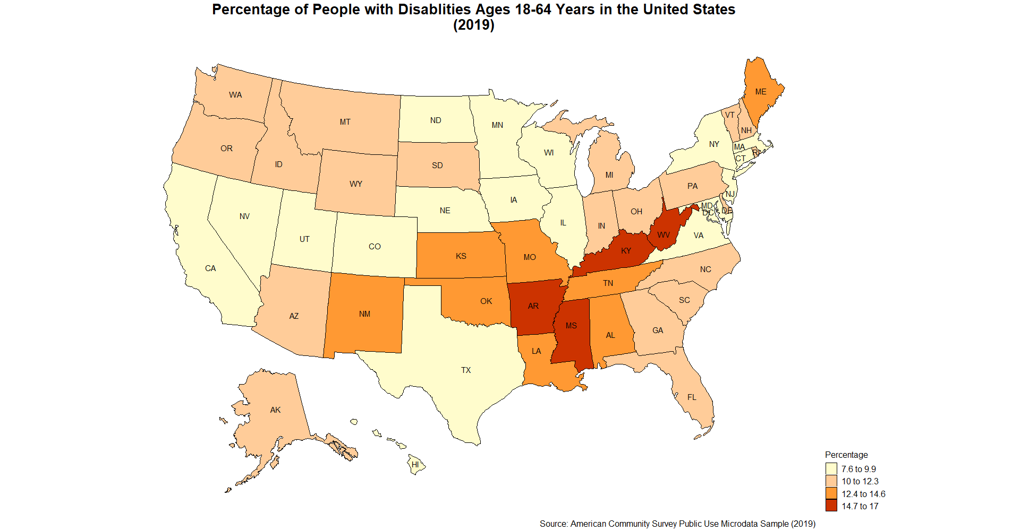
Percentage of people with disabilities in the United States (2018)

Slide 8
Comparing social and economic indicators between people with and without disabilities

Slide 9
High School Education

Slide 10
Undergraduate Education and above

Slide 11
Employment

Slide 12
Earnings

Slide 13
Health Insurance

Slide 14
Private Health Insurance

Slide 15

Think out loud
Why are a greater percentage of persons with disabilities covered by ANY type of health insurance, yet persons without disabilities are more likely to have private health insurance?

Slide 16
Conclusion
Disability prevalence varies across demographic groups.
Age, gender, race/ethnicity, geographic region
• Disability status is associated with different outcomes.
Employment, poverty, insurance coverage
• Future considerations: Disability measurement matters
What is disability? How is disability status captured in these statistics?

Slide 17
References
Paul, S., Rafal, M., & Houtenville, A. (2020). Annual Disability Statistics Compendium: 2020. Durham, NH: University of New Hampshire, Institute on Disability. [1]​
Houtenville, A. and Rafal, M. (2020). Annual Report on People with Disabilities in America: 2020. Durham, NH: University of New Hampshire, Institute on Disability. [2]​
U.S. Census Bureau (2020, July 31). Living with Disabilities Infographic. Retrieved May 14, 2021, https://www.census.gov/library/visualizations/2020/comm/living-with-disabilities.html [3]
U.S. Census Bureau, Current Population Survey, 2008-2018 [4]
​

Slide 18
Answer key
1. (Slide 5) Cognitive difficulty is most prevalent among males, 18-64 years.
​

